Slide 1

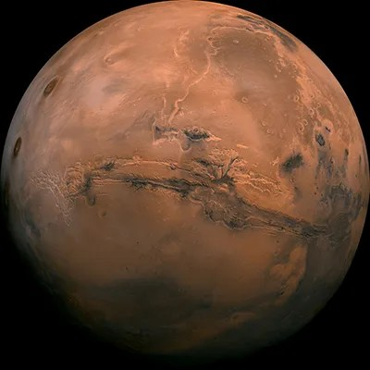
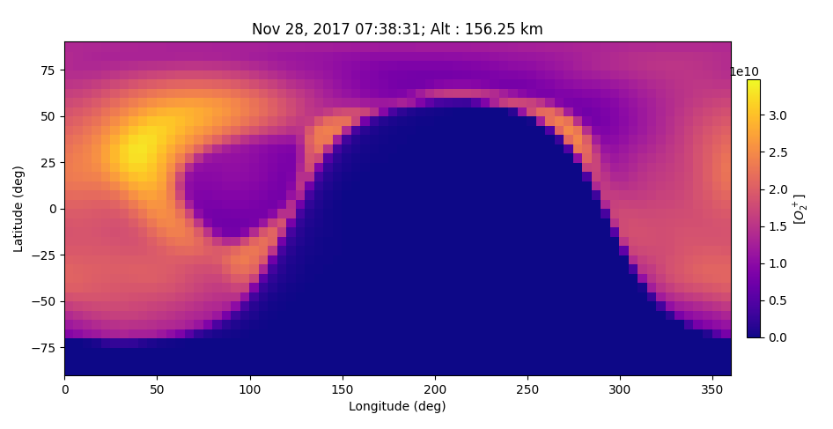



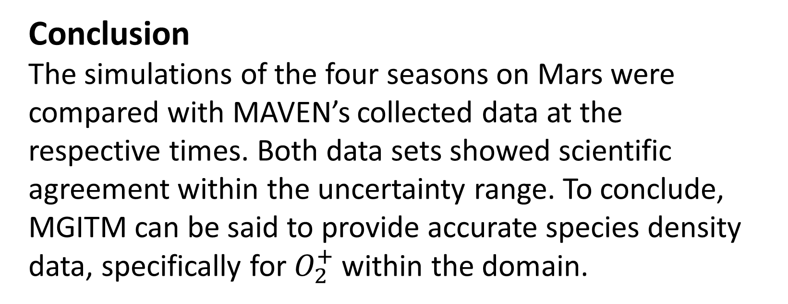
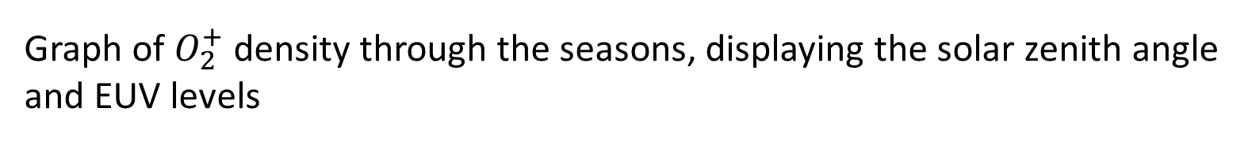

Enhancing a Global Climate Model of the Upper Atmosphere of Mars
Joud Bamehriz
David Pawlowski, Faculty mentor Department of Physics and Astronomy, Eastern Michigan University
Introduction This study utilizes the Mars Global Ionosphere-Thermosphere Model (MGITM), whose domain extends from the planet’s surface to ~250km. The model simulates seasonal changes, species density distributions, and other dynamical changes of the Martian atmosphere. The simulations provide insightful data and plots that then can be analyzed. Specifically, I look at the concentrations of oxygen ions ($O_{2}^{+}$ ) and compare that to NASA’s MAVEN data.
Results
After comparing the results from the simulation with MAVEN’s data most of our data points are within 15% of MAVEN’s data points. 2 of the seasons show great scientific agreement while the other two are within that 15% range. Since this model solves very complicated fluid equations for the whole planet the results can sometimes not reflect reality because it’s just a simulation and the model doesn’t completely replicate reality.
Shown on the graph below are the data points for the four seasons from MAVEN and MGITM. I included the EUV levels because radiation is one of the main factors controlling the species densities in the atmosphere. The solar zenith angle is also another factor because the interactions of the molecules with the sun is what causes the changes and the angle at which the sun enters the atmosphere controls the effects.
Conclusion
The simulations of the four seasons on Mars were compared with MAVEN’s collected data at the respective times. Both data sets showed scientific agreement within the uncertainty range. To conclude, MGITM can be said to provide accurate species density data, specifically for $O_{2}^{+}$within the domain.
Methodology
Data retrieved from MAVEN’s Neutral Gas and Ion Mass Spectrometer (NGIMS) and $O_{2}^{+}$ ion abundance rows specifically extracted
The selected files represent the four Martian seasons
The simulations were run for each one of the seasons to make sure that the model is accurate through a Martian year, which is equivalent to 2 earth years
A python code was executed to get a value of $O_{2}^{+}$ concentration using the model’s resulting files at a specific longitude and latitude that matches MAVEN’s data set
Graphs were generated to show scientific agreement across the four seasons.
A sample graph showing the density of $O_{2}^{+}$ across the globe of Mars from the summer simulation. Generated using MGITM.
Graph of $O_{2}^{+}$ density through the seasons, displaying the solar zenith angle and EUV levels
Benna, M., & Elord, M. (2019). Mars Atmosphere and Volatile Evolution (MAVEN) Mission Neutral Gas and Ion Mass Spectrometer (NGIMS): NGIMS PDS Software Interface Specification (Rev. 1.12). NASA. https://lasp.colorado.edu/maven/sdc/public/data/sdc/web/instrument_docs/ngi/ngims_pds_sis_v02_r01.pdf
Bougher, S. W., Pawlowski, D., Bell J. M., Nelli S., McDunn T., Murphy J. R., Chizek M., & Ridley, A. (2015). Mars Global Ionosphere-Thermosphere Model: Solar cycle, seasonal, and diurnal variations of the Mars upper atmosphere. Journal of Geophysical Research Planets, 120, 311–342. Doi: 10.1002/2014JE004715.
NASA, JPL-Caltech. (2013). Mars Planet Globe [online image]. Mars Exploration Images. https://mars.nasa.gov/resources/6453/mars-planet-globe/
MAVEN Science Data Center. NGIMS data. https://lasp.colorado.edu/maven/sdc/public/pages/datasets/ngims.html
References:
An altitude vs density profile from MAVEN. In a single orbit MAVEN collects all these different densities of $O_{2}^{+}$ at different altitudes.
Mosaic of the Valles Marineris hemisphere of Mars , taken as a 102 separate images that are then projected into point perspective.
Eastern Michigan University
Joud Bamehriz
Jbamehri@emich.edu

